Slide 1
IIITDM HANGOUTS
By – Var Gen Coders

Slide 2


What is IIITDM Hangouts ??
The more spoon-fed a process is, the more it is welcomed by the users.
The reason multiple social-networking apps are able to flourish is that, each of them make different processes simpler.
It really is tiring to wait for replies when you want to know where your friends are at and not everytime you call will they be able to pickup.
THERE IS A SOLUTION…
An Exclusive mini social network app just made for our college : IIITDM HANGOUTS
Specifically made for students in colleges to make their life simpler.

Slide 3
Features of IIITDM Hangouts :
Check live activities in crowded places like sports complex, Canteen/Cafeteria, Mess, Library, Acads Building….etc.
Search the live location of the person you want to know the location if you just want to know his/her location.
Share your location and status to our exclusive IIITDM community .
Set duration for your location and status to reduce confusion.

Slide 4
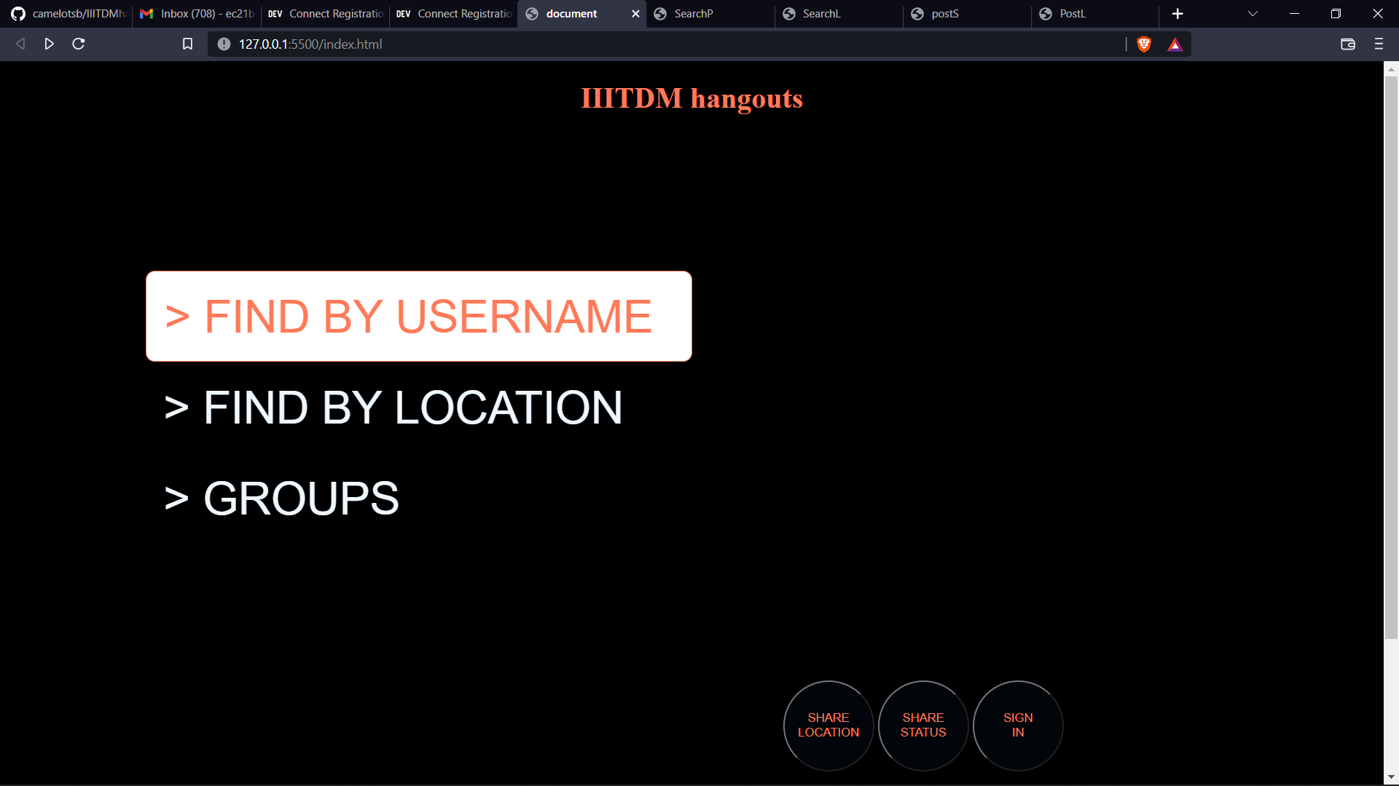

Slide 5
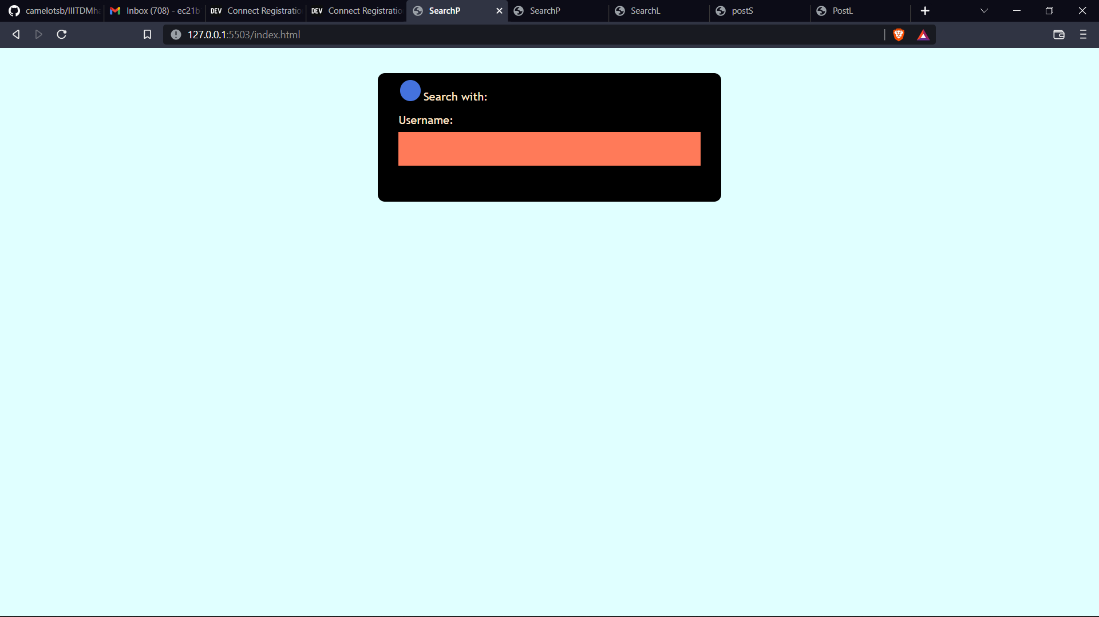

Slide 6
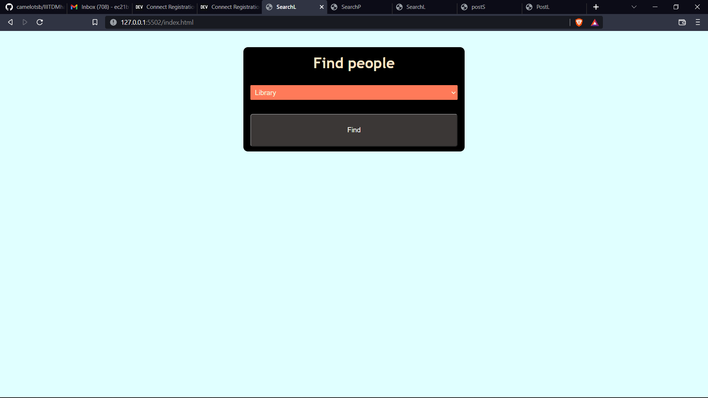

Slide 7
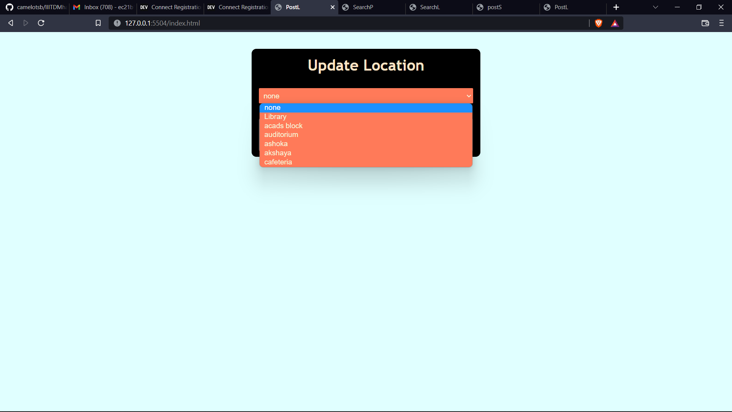

Slide 8


Slide 9
Future Scope and Potential :
Having a personal community to make this app even more exclusive.
Crowd Alert feature, where you will get a notification if there is a huge crowd in a certain location.
Variable status change, where the status automatically changes if you are constantly moving around
Personal status , which can make the app even more specific.

Slide 10
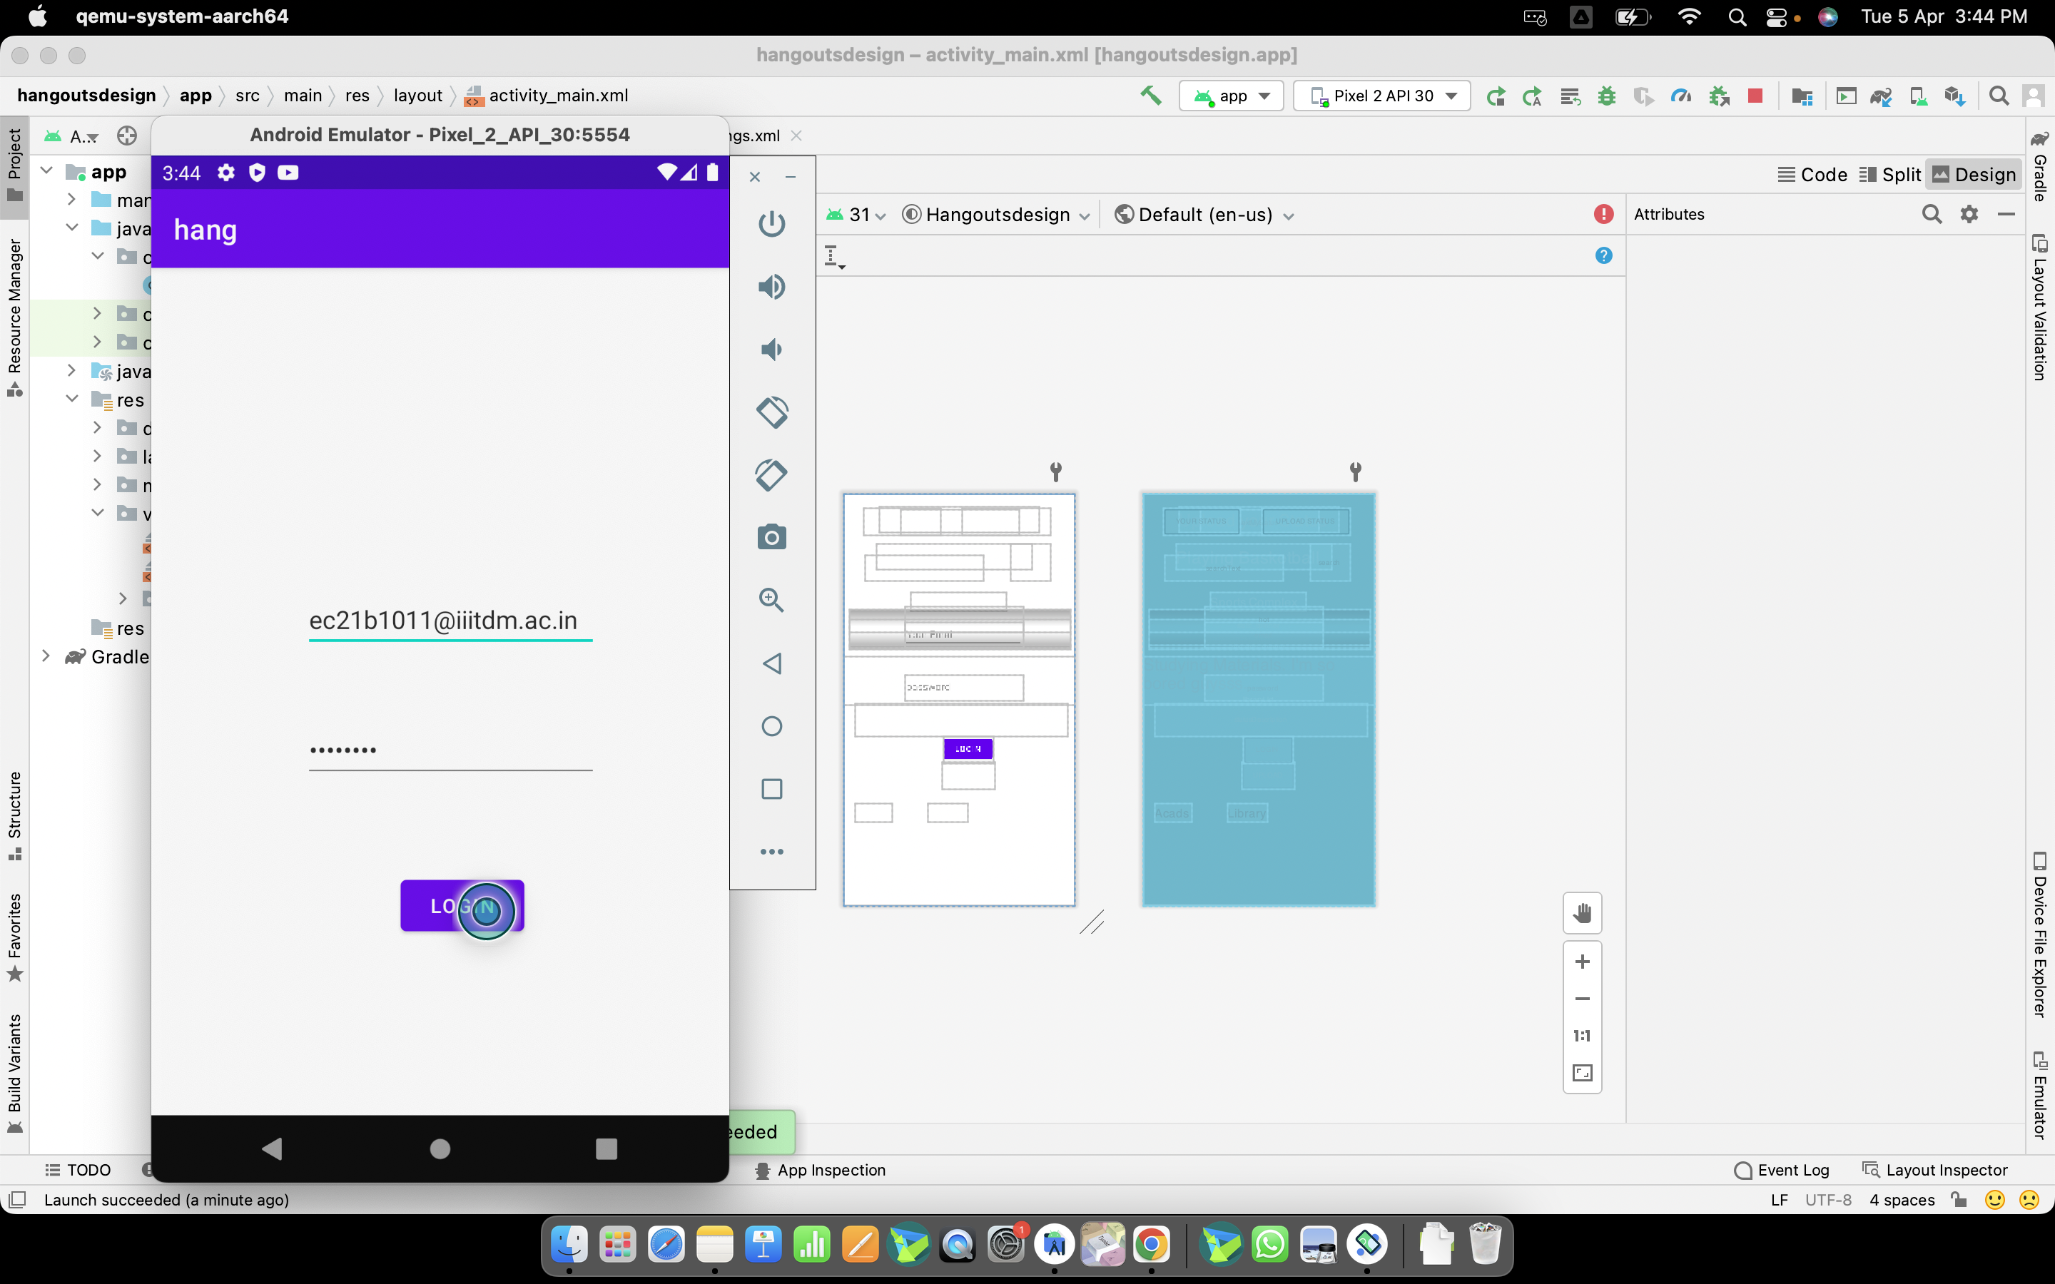

Slide 11
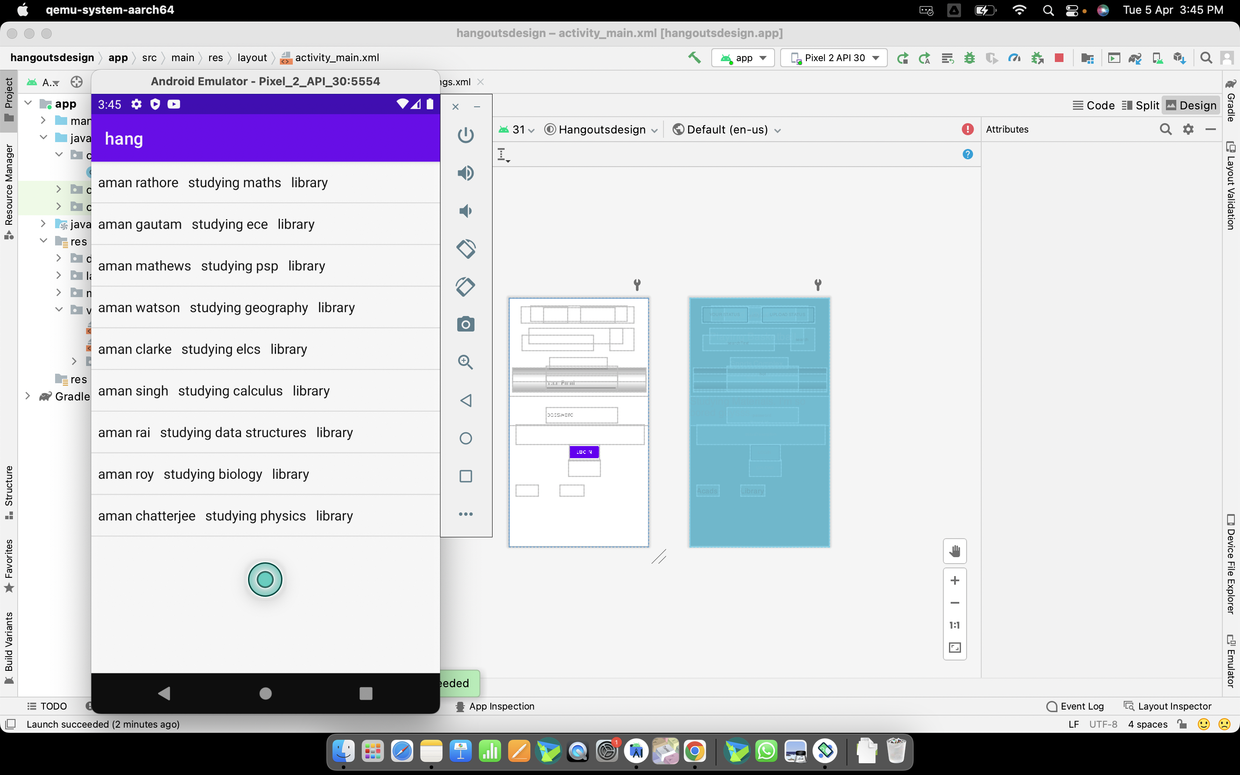

Slide 12
USECASES :
For faculties : (“Special Profiles for Faculties”)
What if the faculties wants to arrange a important extra class or meeting, rather than sending an email (which is not that efficient) , the faculty could update his status to “ IMPORTANT” and all the students will be immediately notified.
The faculty can also monitor the number of students gathered in an arranged place.
If the faculty is free to clear doubts to a particular set of people, he can make his location visible to the group of people he wants to.

Slide 13
For Students :
Not always a student can pick-up the call , such as when he is in a library , sports ground , Acads Building etc.... But he wants to reply to them or tell others where is he and wants to know where others are there, That’s when our app comes in help, He/She could just update his status to inform everyone.
Now he wants to hangout happily after spending time studying and wants to know where people are hanging out in common places like cafeteria , mess , seminar hall etc… and find if there are anyone who is there to hangout with you.

Slide 14
For Staffs(Wardens & Security Staff) :
Wardens and Security staff hold the responsibility on the welfare of students in the respective hostels. In that case if they want to know where the student is when they found out a student is missing (not in the hostel room) they can use the app to know where he/she is which would help them a lot
In covid times , unauthorized crowding is prohibited hence this app also helps them locate such crowds. If they find out there a group of people gathering and not following covid sops they could easily find them out and take necessary actions quickly.

Slide 15
General Case-Scenario:
The main purpose of this app is to connect people like friends, colleagues , faculties etc… But in a diverse college like IIITDM where there students and faculties are from various parts of this country , which makes it tough for organizing and finding things, this gives a solution.

Slide 16
This app is a platform where we can do all the mentioned stuffs in a user friendly interface and also makes the whole college life easier, fun filled and also special cause the whole college community will be exclusive .

Slide 17
THANK YOU
- VAR GEN
Sibi M
Yuvraj Singh
S.Sundar Subramanian
M.VibhavGopal.L.N

